Slide 1
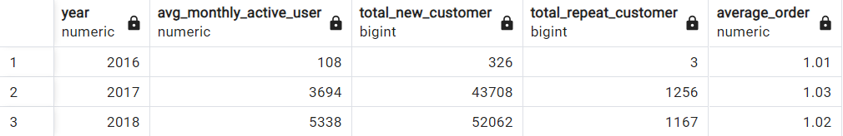
Annual Customer Activity Growth Analysis
Overview :
The increase in growth customers is a reflection of the effectiveness in sales. That's why customer growth is one of the main goals of an e-commerce company. It is not only essential to grow our customers but also to retain them. One of the metrics used to measure eCommerce business performance is customer activity that interacts on the eCommerce platform. In this section, we will conduct an Annual Customer Activity Growth Analysis by analyzing the development of several business metrics per year such as monthly active users, total new customers, total customers who make repeat orders, and average order value. This will provide insight into whether the eCommerce business's performance in terms of customer activity has grown, remained stagnant, or even declined over the past year.
Here is the summary table of monthly active users, total new customers, total customers who make repeat orders, and average order value performance :
The full query can be found here

Slide 2
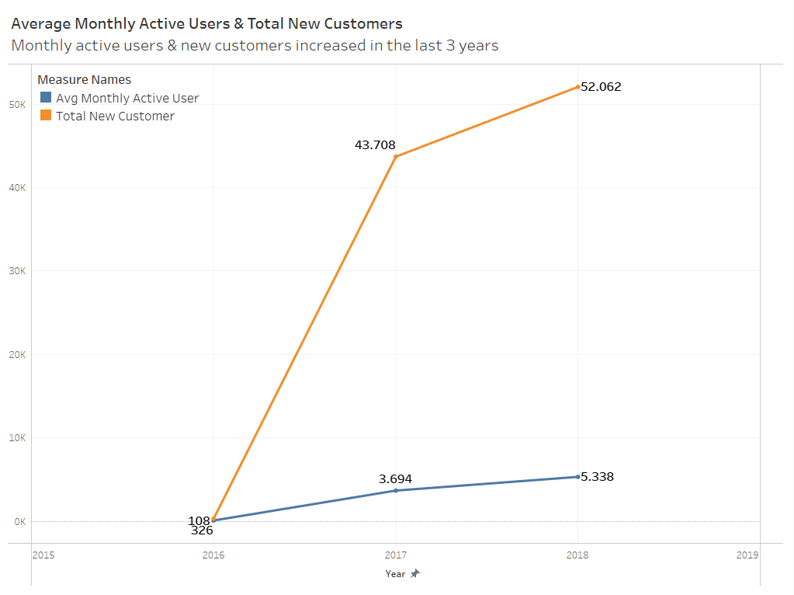
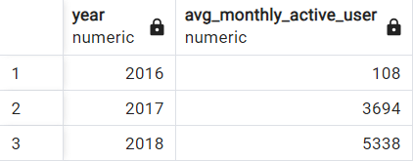
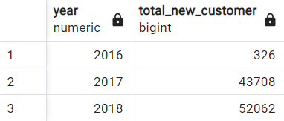
Annual Customer Activity Growth Analysis
1. Average monthly active user (MAU) per year
Displays the average number of monthly active users (monthly active users) for each year
2. Total new customers per year
Displays the number of new customers in each year
Insight :
More active users suggest that the e-commerce platform is effectively engaging its audience, leading to higher user retention and loyalty. It indicates that the platform is providing valuable products or services that resonate with customers.
A rise in the total number of new customers indicates that the e-commerce business is successfully acquiring new clients. This could be due to effective marketing strategies, improved product offerings, or enhanced user experience, all of which contribute to business growth.

Slide 3
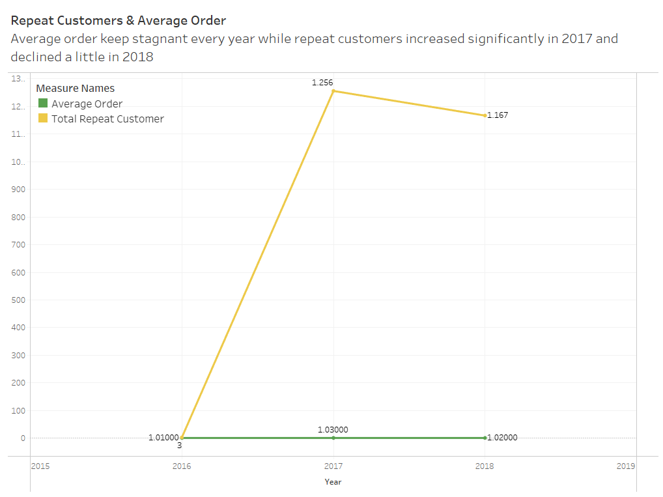
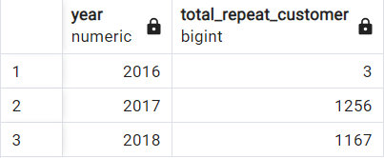
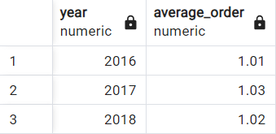
Annual Customer Activity Growth Analysis
3. Total customers who make repeat orders per year
Displays the number of customers who make purchases more than once (repeat orders) in each year
4. Average order value per year
Displays the average number of orders made by customers for each year
Insight :
The significant increase in total repeat customers suggests that the e-commerce platform has been successful in retaining existing customers. This could be due to factors such as excellent customer service, product quality, or loyalty programs. The decline in the next year could indicate that these efforts to retain customers may not have been sustained or that competition has intensified.
The stagnant average customer order per year may indicate market saturation or a plateau in consumer spending habits. Customers may be making repeat purchases but not increasing the frequency or value of their orders. This could be a sign that the e-commerce platform needs to explore new markets or diversify its product offerings to stimulate growth.

